Slide 1
If you want to follow through the demo…
Download and Install
NodeJS download - https://nodejs.org/en/download/
Robo 3T download - https://robomongo.org/download
Connect to the sample db using Robo 3T – IP: 54.169.42.64, port: 27017, database: simple_demo, user: demo_user1, password: funnycat
Demo project- https://github.com/francisleunggie/simple_demo
Detailed instruction – Running NodeJS Application.docx
Sample DB script – db_script.txt
Sample code – simple_server.js
Download Sample Project

Slide 2
How to Create a WebApp with NodeJS and Why Should I Care?
29..11..
Francis Leung

Slide 3
Agenda
Why NodeJS?
What is NodeJS?
How to code in NodeJS?
Live Demo

Slide 4

About Me
Cloud Specialist in Oracle
Coded professionally for 11 years
Job history – Developer, Business Analyst, Project Manager
Academic: NUS (SOC), ITIL, PMP, AWS, CFA…
Favorite languages – NodeJS, Ruby, PL/SQL, Pascal
Least Favorite languages – c#, c++, PHP
Neutral – Python, Perl, Java
Application profile:
High performance
Risk calculator
Trade processing network
Web / Mobile
Numerous Java, Ruby, NodeJS web applications
Educational Software
An Android App (credit card wallet)
Blockchain
Ethereum App (Visualizer for a DApp)
Cyber Security
Automatic Vulnerability Assessment System

Slide 5
Why NodeJS?

Slide 6
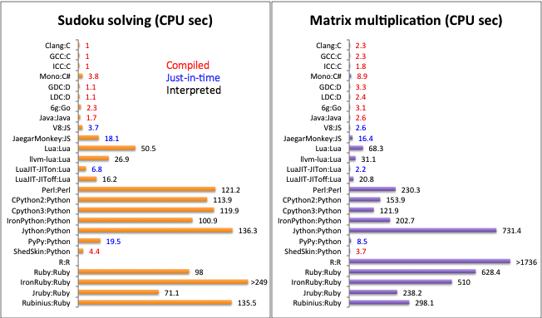
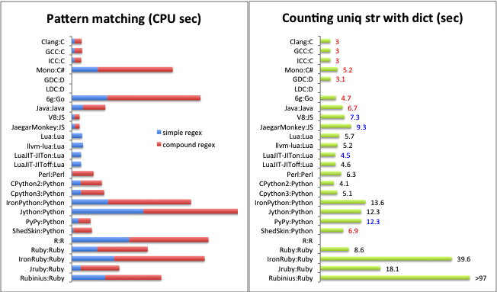
Facts about NodeJS
😉
Who uses it in big ways?
LinkedIn Netflix
Trello Walmart
Uber PayPal
Medium Groupon
How about ranking among languages (2017)?
Github – No. 1
Tiobe – No. 6
IEEE – No. 7
Dzone – No. 7

Slide 7
Is it worth my time?
But the real question is…

Slide 8
The WMT Factors
“Worth My Time” Factors
Employability
Longevity
Learnability
Community Support
Ease of Development
Performance
Safety

Slide 9
Purely Personal Point of View
 | NodeJS | C++ | Java | Python | Ruby
Employability | a | a | a | a | Slower growth
Longevity | a | a | a | a | s
Learnability | a | r | So-so | a | a
Community Support | a | r | a | a | a
Ease of Development | a | r | r | a | a
Performance | Good Enough | a | a | So-so | r
Safety | So-so | So-so | a | Good Enough | So-so

Slide 10
Famous use cases
😸
Major tech firms are pouring in resources to drive NodeJS forward
PayPal – high throughput payment service
Walmart – Walmart.com
LinkedIn – the entire website
Uber – order matching service
Netflix – distribute and stream media data
CapitalOne – Dashboards, API
GoDaddy – frontend platforms
Groupon – frontend services like API client libs, caching lib, web testing tools

Slide 11
What is NodeJS?

Slide 12
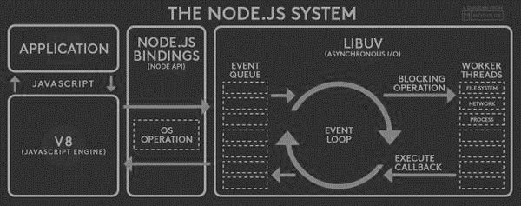
What is NodeJS?
The Official Answer
JavaScript as Server-side language
Non-blocking
Unique event model
Thread-free
Supports inter-process communication
Runs on V8 (Chrome JS engine)
Compiled instead of interpreted
V8 compiles JS files
NodeJS Bindings provide OS level library hooks for compiled NodeJS code
LibUv abstracts LibEio, Libev and other low level libraries to perform IO and manage events in the event pool. It picks up events from queues, sends blocking ops to worker threads and executes callbacks when ops are completed. With Bindings and V8 it completes the lifecycles of events.

Slide 13
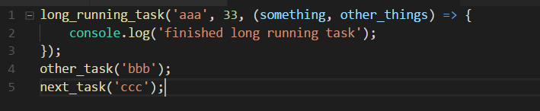
Non-blocking
In order languages
long_running_task will have to finish before other_task and next_task can start running.
In NodeJS
other_task will start before long_running_task finished running
next task will start immediately after other_task has started

Slide 14
Parallelism comparison
- 1st class citizens
- has private memory space
Process
- All 1st class citizens
- All have private memory space
Main Process
IPC
IPC
- children of processes
- no private memory space
Child Process
Child Process
Child Process
threads
In order languages
Parallelism can be achieved with multithreading
Threads are 2nd class citizens, having less authority, power
Threads can talk to processes, but processes do not intercommunicate
In NodeJS
No multithreading – all are single-threaded
Parallelize by spawning child processes
All child processes can communicate with their parent
Horizontal scaling can be done this way

Slide 15
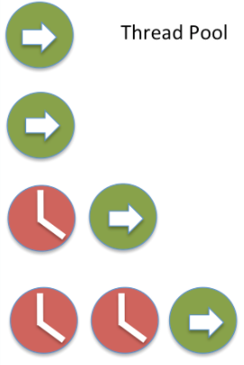

Multithreading vs non-blocking
NodeJS with single thread
Blocking I/O
Non-blocking I/O
In order languages
Multithreading to parallelize tasks
During IO operations, other threads will still need to wait for the unblocking
Context switching between threads adds overhead
In NodeJS
Fire and “forget” until callback
Offload long running tasks to system kernel
When tasks are done, callbacks will be added poll queue and eventually be executed.

Slide 16
Compiled vs interpreted
Scripting languages including JS are mostly interpreted. Codes are executed from the top line by line.
V8 compiles and optimizes NodeJS scripts before execution
With interpreted JS or other script langs
Flexible (dynamic) typing
Platform independence
Simple reflection through evaluation
Slow execution
Susceptible to code injection
In NodeJS (has all adv. on the left)
Fewer dictionary or method lookups
Replacing original code with optimized code
Reducing no. of method calls
Remove unnecessary or ineffective code

Slide 17
What is NodeJS? (developer edition)
“Ask the right questions”
What language is it?
JavaScript (on the server-side)
What so special about it?
High IO performance, good for web, network, distributed applications.
What’s the difference between browser and server side JS?
Browser JS uses HTML to make different JavaScript codes work together. NodeJS uses the “require” keyword.
What OS platform supports it?
Linux, Windows, Mac, AIX, Solaris, 32 / 64 bit
How to use open source libraries?
NPM (node package manager)
How to create a NodeJS app and run it?
Just create it with text editor and type “node <js filename>”

Slide 18
What can/can’t you build with NodeJS?
When to use
Real-time applications
Event monitoring dashboards, trading screens, most web apps
Data streaming services
Media transcoder, video streaming, IoT
Messaging applications
Chat systems
APIs fronting DB / Services
Restful APIs
Network services
Reverse proxies
When NOT to use
😒 CPU intensive applications
Mining
😒 Relational database applications

Slide 19
What is MEAN Stack?

Slide 20




NodeJS and Friends
MongoDB – One of the most efficient non-SQL DB, supports versatile and complex single-collection queries
Expressjs – an unpretentious yet elegant framework for creating / managing servers for dynamic web pages and RESTful APIs
Angularjs – a browser side framework that combines MVC and MVVM design patterns - a perfect combination of control and no-fuss presentation
Nodejs – a server side framework that most notably makes use of JS’ asynchronous nature

Slide 21
MongoDB
Basic facts:
A “NoSQL” database, queries in JS and data in JSON
Allows the storage of unstructured datasets (as well as structured)
Good for fast random access
Good for storing voluminous / rapidly growing datasets
Improves performance without costly hardware via sharding
Ensure resilience with read replica
Not so good with complex queries
ACID only at document level
Analogy with Relational Database:
Relational DB |  | MongoDB
Tables | ~= | Collections
Records | ~= | Documents
Columns | ~= | Attributes
Column Names | ~= | Attribute Keys
Indexes | == | Indexes
Joins | ~= | Aggregation with $lookup
Select clause | ~= | Aggregation with $project

Slide 22
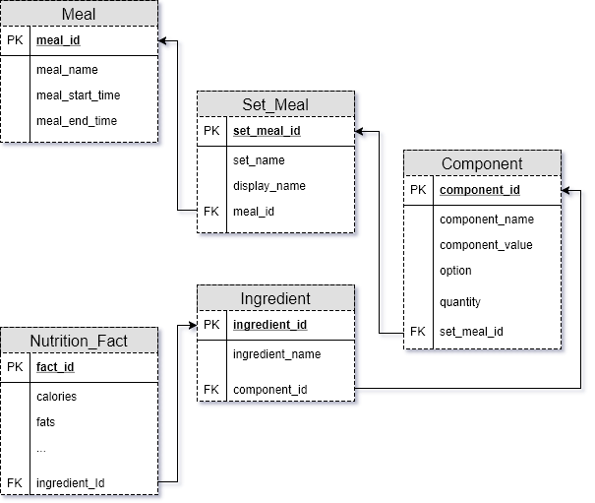
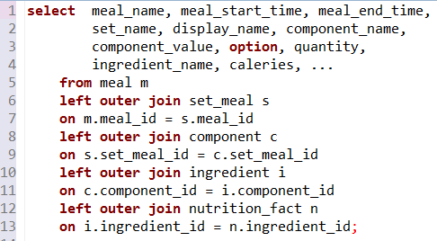
Relational DB Revision
a row == a record
structure –
simple structures – each record is just a flat linear row
commonly stores in 1NF
results of joins are just flat linear rows
flat structure allows joins without introducing complexity
joins can be accomplished by matching FK (foreign key) to PK (primary key)

Slide 23
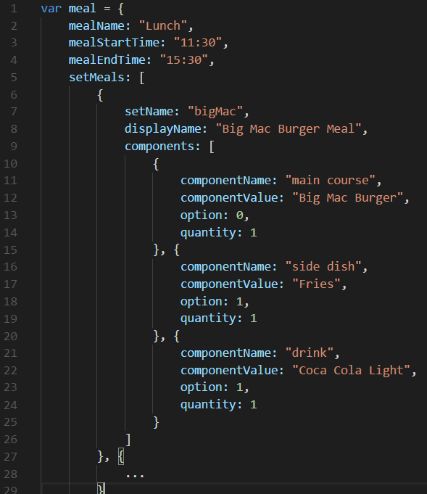
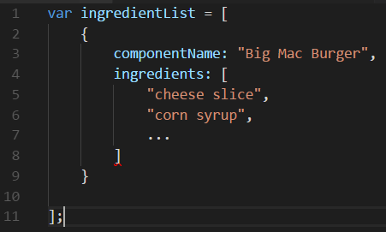
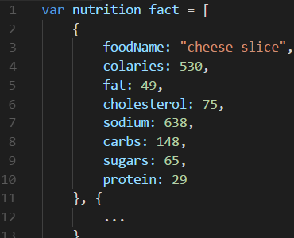
Unstructured Dataset
a document == a record
structure –
every object is made up of attributes in key-value pairs
no fixed structure
nested and hierarchical
joins in queries quickly increase complex
imagine joining the main document to the ingredient list and then to the nutrition facts, the document tree gets bloated up by a few times

Slide 24
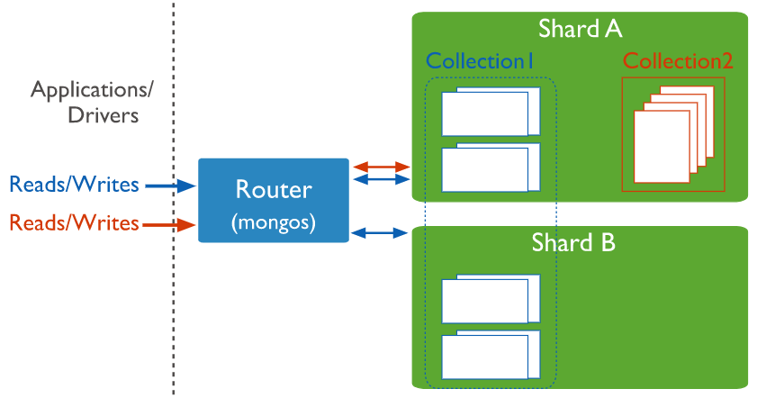
Shards improves performance
Sharding is a horizontal scaling strategy
Cut each collection into partitions, and place them in different servers
With each collection spreading across different servers, data access can be done in parallel
Overcomes I/O throughput limits with parallel disk read / write
Unlike vertical scaling, no need to purchase expensive hardware to increase throughput

Slide 25
ExpressJS
Basic facts:
A Web Application Framework for NodeJS
Allows rapid development of web applications and APIs
Handles cross-cutting concerns with middleware
Simplify UI development with template engines
High performance, simple, elegant
Great framework! Most common component of any NodeJS app
Basic component and usage:
Component | Usage
Middleware | Process incoming requests in a homogeneous manner. Good for error handling and other basic request handling
Routing | Used to match requests to their handlers via the request URLs. Same function as WebRequest annotation in Spring but more powerful.
Template engine | Render web content dynamically using variables within templates

Slide 26
AngularJS
Comparison with ReactJS (close alternative) and JQuery (old but still widely-used):
Basic facts:
A frontend framework that renders dynamic web content from the client end.
2-way data binding (important!)
Easier behavior management with dependency injection
Non-intrusive – doesn’t mess with the DOM directly with application code
Separation of concern (MVC model)
Simple to use after getting familiar
Not good with too many screen elements
Steep learning curve
Good framework despite drawbacks
Property | Winner | Loser
Easy to learn | JQuery | AngularJS, ReactJS
Easy to maintain | AngularJS, ReactJS | JQuery
Performance | ReactJS | AngularJS, JQuery
Easy to test | AngularJS, ReactJS | JQuery
Community Support | AngularJS, ReactJS, JQuery

Slide 27
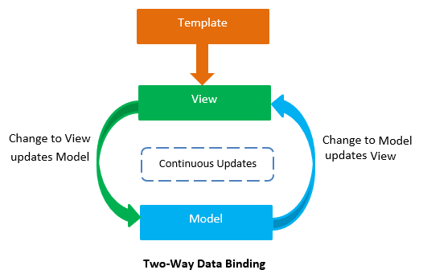
2-way data binding
When data on screen changed by users, model at the server will be updated accordingly (depending on implementation, update can go straight-through to the DB)
DB data changes can be pushed to screen without additional codes to re-render the on-screen components

Slide 28

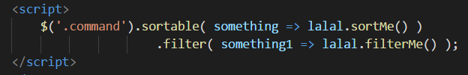
Dependency Injection
I want to be sortable by “command” column values
I want to be filter-able by “command” column values
DI allows screen elements to decide what dependencies affect their behaviors
JavaScript from somewhere determines the behavior of screen elements without DI
In a collaborative project, info of what JS is affect what screen element can be very unclear

Slide 29
Why We use MEAN Stack?
😸
Best kept secret – same language from front to back
1 language to become a full-stack developer
Much more productive – no context switching
Accelerated improvement - 1 ecosystem to practice and practice

Slide 30
How to learn NodeJS?

Slide 31
Basic Pre-requisites
Hardware & OS – nothing specific. Recommended – get a free-tier AWS EC2 t2.micro
Developer tools (all free)
Text editor or IDE (Recommended – Visual Studio Code)
Install NodeJS >= v5.x, MongoDB >= v3.4, Npm >= 3.x
Git account
Robo 3T (for MongoDB)
Knowledge
0 – Feasible for brave new learners
Basic JS / web development experience

Slide 32
How to become good at NodeJS?
2 Paths:
Brute force!
Work on practice challenges with one after another (those with worked answers)
Practice challenges are better to be accompanied with troubleshooting guides, best practices and explanations
Basic random online “task list” tutorials are not sufficient to fully understand many concepts in MEAN
Theory first, then gradual progression
Tackle MEAN components one by one
Documentation reading
Planned learning approach – reinforce newly learned theories with relevant micro-practice challenge
Integrated practice challenges – after enough familiarization, go through a series of integrated challenges
Expected outcome: Able to build complete applications, but only a rough idea of individual components. Able to progress as a NodeJS developer.
Expected outcome: Able to build complete applications, and gain deep knowledge of the individual components. Able to solve complex problems with NodeJS

Slide 33
Hands-on demo simple 1-page application displaying a data table

Slide 34
Mission
 | Mission Statement | Status
1. | Create a 1-page NodeJS web application | Not started
2. | Load an excel sheet of data into MongoDB | Not started
3. | Display the list of employees in the 1-page application | Not started
4. | Make sure the application is always showing the latest information | Not started
5. | Do everything within 1 file, In fewer than 30 lines of code, and Do not use any external library except for MongoDB driver | Not started

Slide 35
If you want to follow through the demo…
Download and Install
NodeJS download - https://nodejs.org/en/download/
Robo 3T download - https://robomongo.org/download
Connect to the sample db using Robo 3T – IP: 54.169.42.64, port: 27017, database: simple_demo, user: demo_user1, password: funnycat
Demo project- https://github.com/francisleunggie/simple_demo
Detailed instruction – Running NodeJS Application.docx
Sample DB script – db_script.txt
Sample code – simple_server.js
Download Sample Project

Slide 36
Steps
“We should always plan our way before attacking the keyboard”
Create a folder called simple_demo
Run “npm init” and “npm install mongodb --save"
Create a file called simple_server.js
Create the http server in the simple_server.js
Create the database, the user, the collection
Create a JSON from the excel file
Load the JSON into MongoDB
Modify simple_server.js to display the data
Check that all mission statements are fulfilled
{{ The End }}
http://localhost:8000

Slide 37
Basic Syntax Revision
 | Basic Tasks | Code sample
1. | Declare a constant / variable | const str = “abc”; const integer = 3; var arr = [“ab”, ‘cd’, `ef${a_variable}`];
2. | Creatng a function | (param1, param2) => { …; } funciton(param1, param2) { …; };
3. | Write a conditional statement | if (err) …; else …;
4. | Looping | arr.forEach( (item, idx) => { …; } ); for(var i=0; i < arr.length; i++) { …; }

Slide 38
Code sniplets required
 | Tasks | Code sniplet
1. | Load a library | require(‘<library_name>');
2. | Create a mongodb connection string | const mongo_url = 'mongodb://<db_user_name>:<password>@<ip_address>:27017/<db_name>';
3. | Create mongodb connection and start querying | MongoClient.connect( mongo_url, (err, <db_object>) => { … }); });
4. | Creating a server | require('http') .createServer( (req, res) => { … }) .listen( <port number>, (err) => { … });

Slide 39
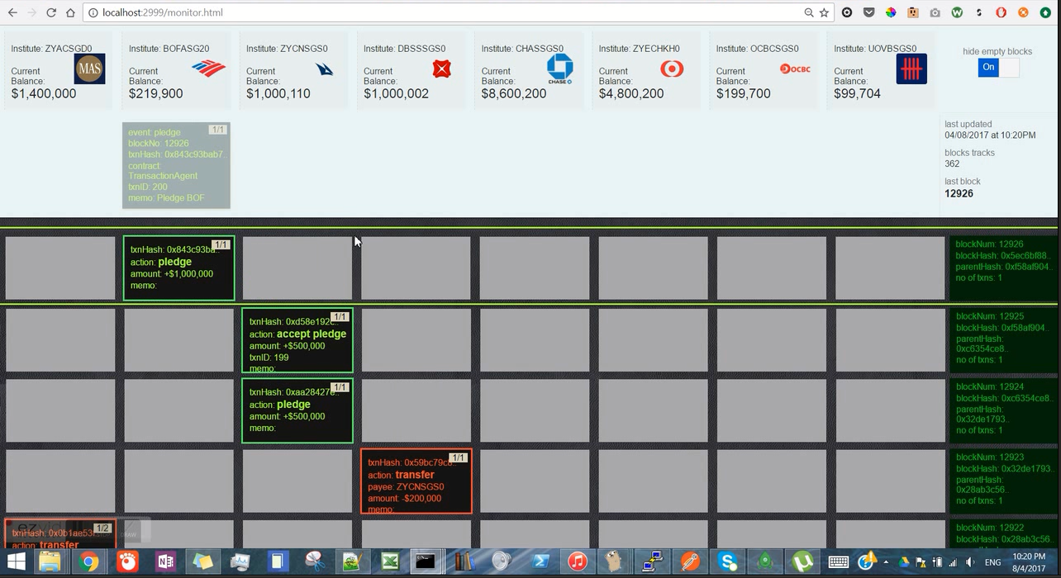
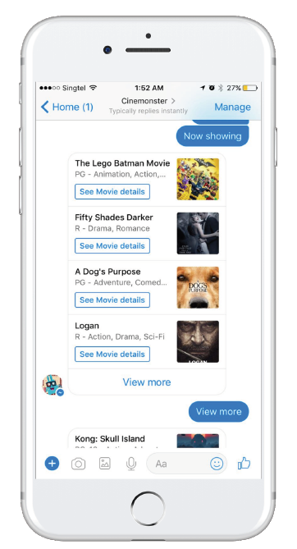
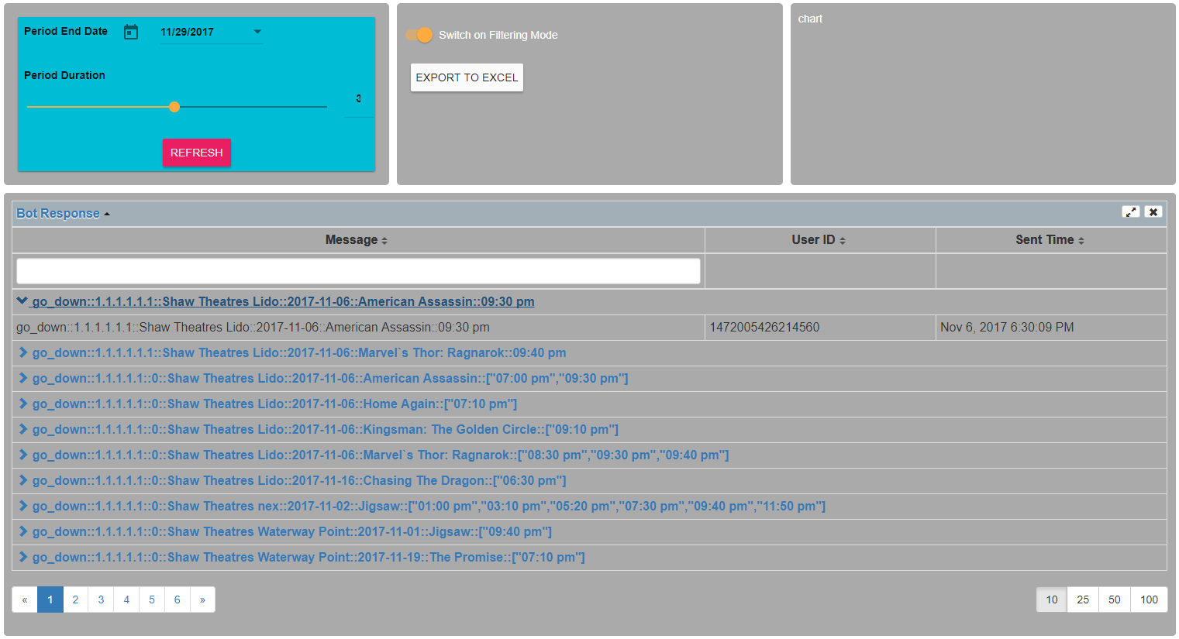
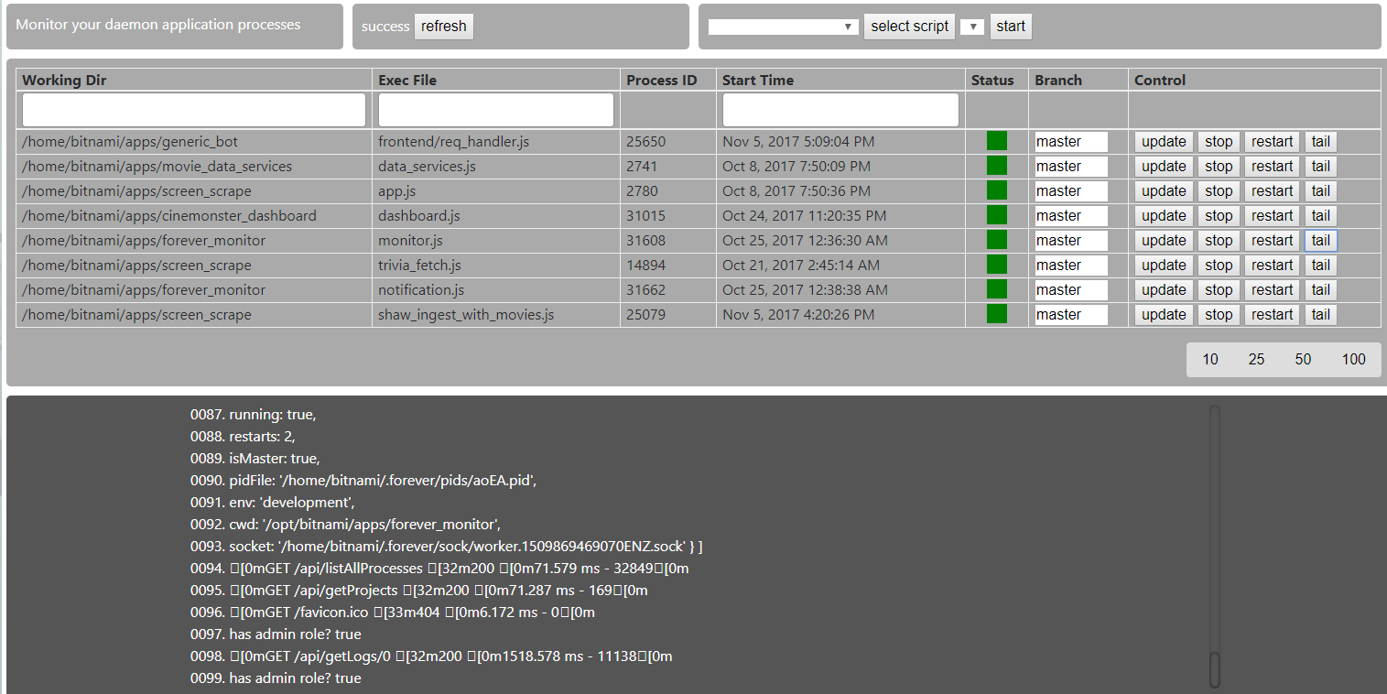
SAMPLES

Slide 40
Creating Real-World Applications with NodeJS
Lesson Plan
Initialize (H):
language & tools introduction, environment setup
Boot-up (H):
NodeJS basics
Keeping it real (H):
Introduction to ExpressJS and API
Persistence (H):
introduction to MongoDB
Reboot (H):
introduction to AngularJS
Solutioning:
Identify and break down problems, and creating a solution to it with NodeJS
Authentication (H):
Introduction to Passport
Authorization (H):
Introduction of ACL and Mocha
Testing and Conclusion (H):
Testing with Mocha and project presentation
The Final Project is an Integrated Practice Challenge that crystalize students’ understanding of the MEAN stack usage and web development concerns.
H – Hands-on

